Slide 1
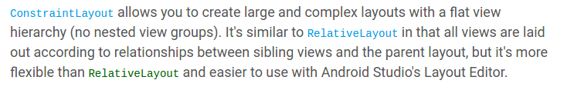
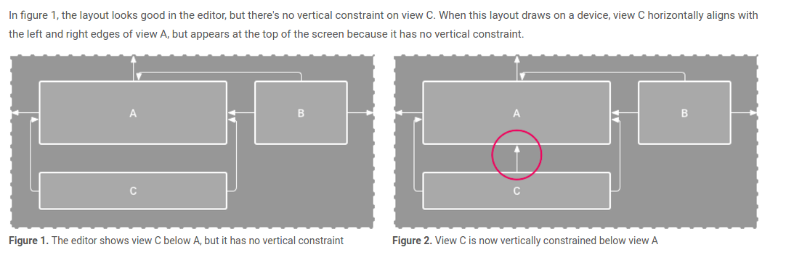

Slide 2
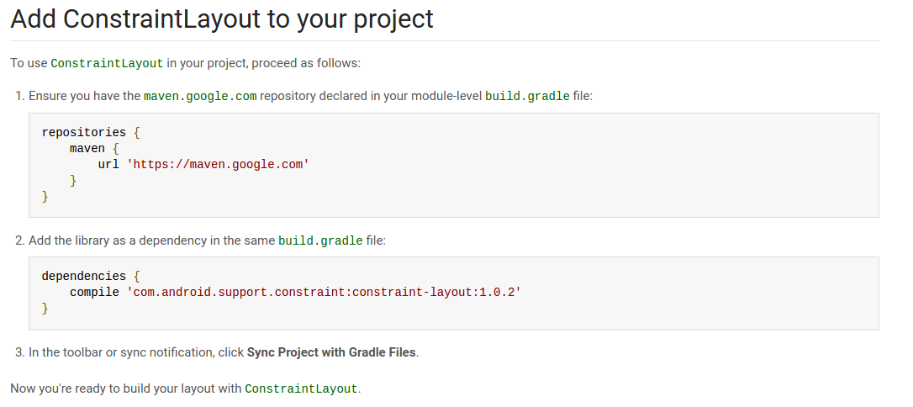
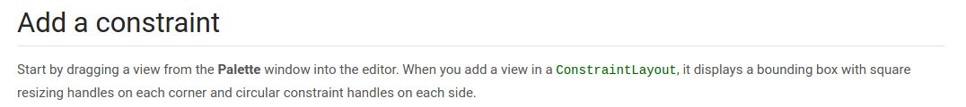
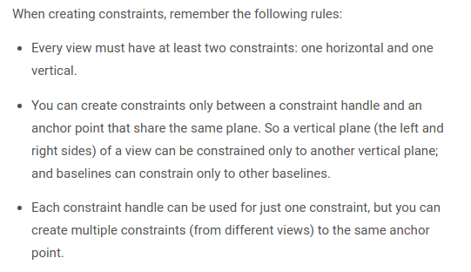

Slide 3
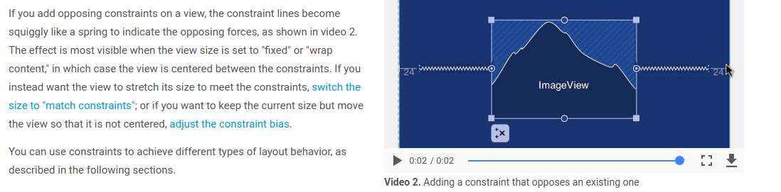
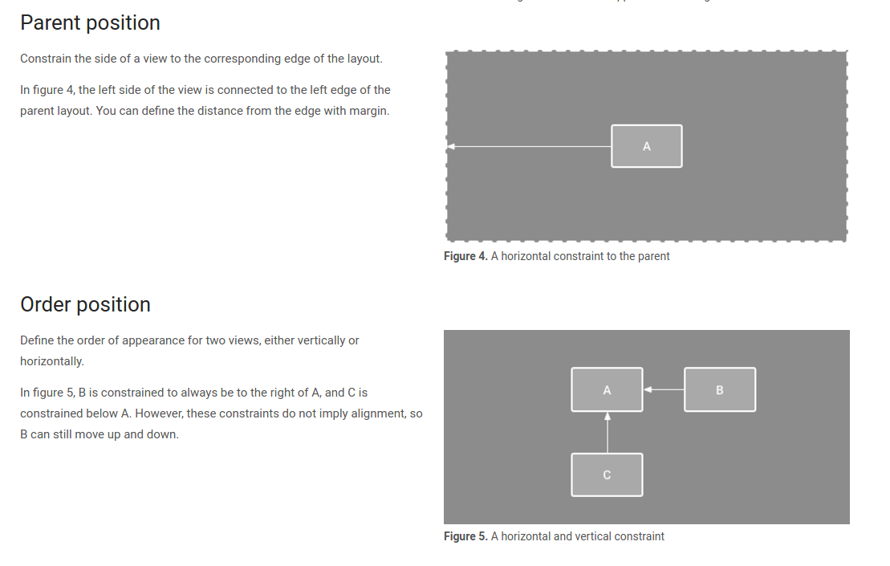

Slide 4
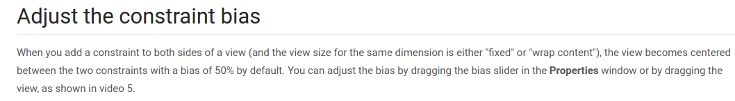
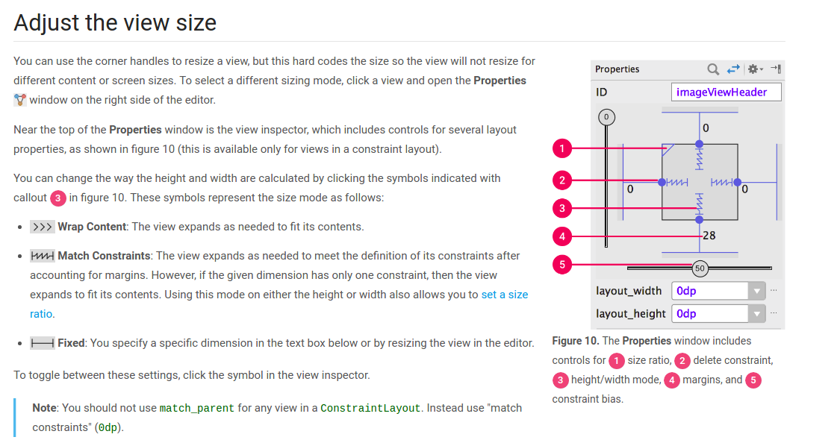

Slide 5
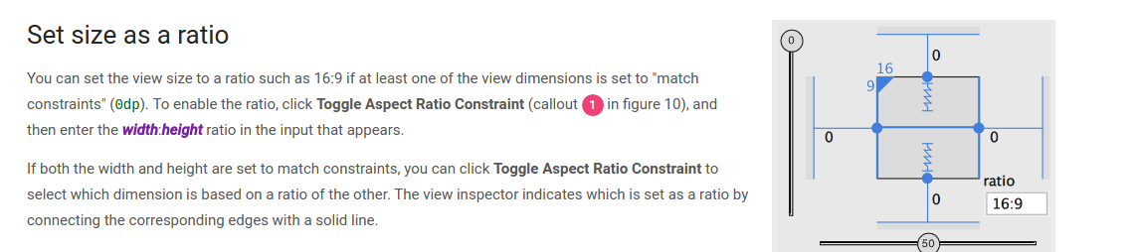
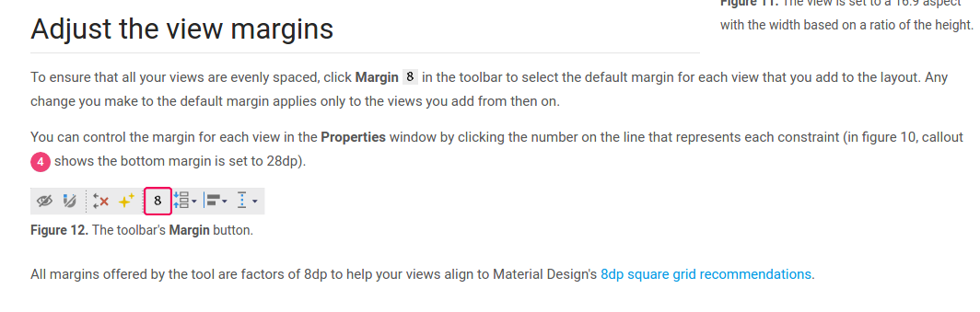

Slide 6
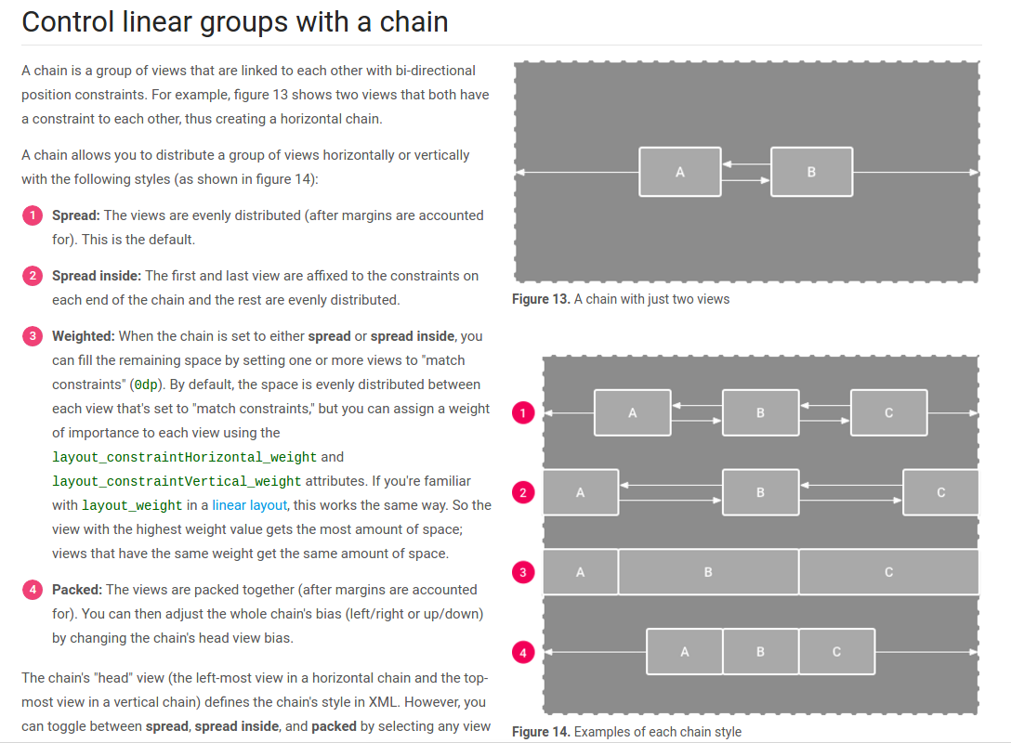

Slide 7
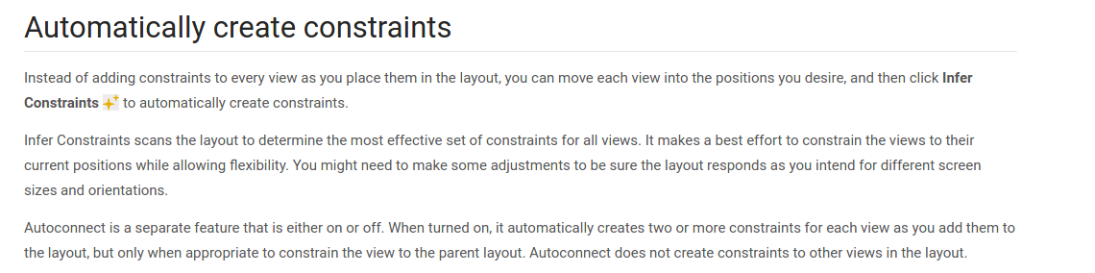

Slide 8
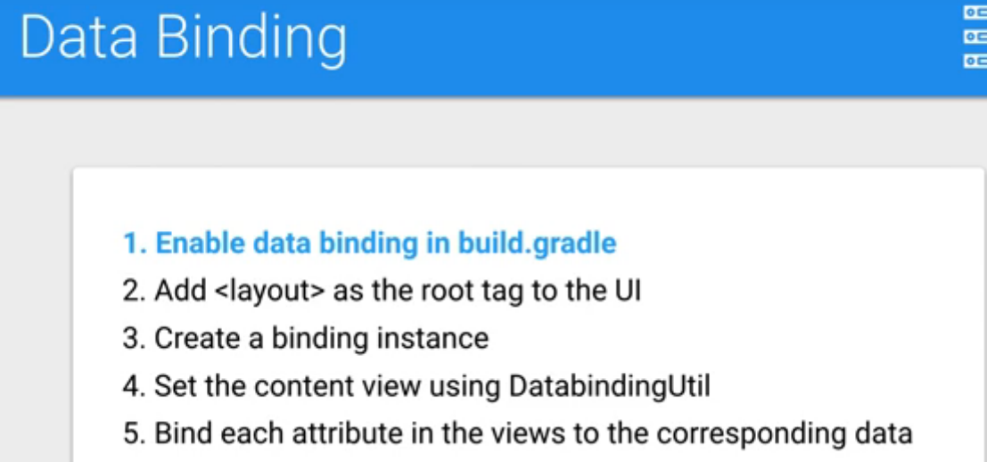

Slide 9
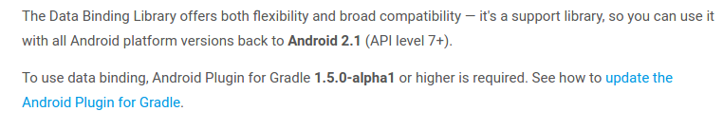
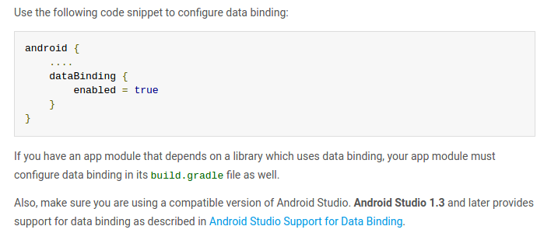
2. after adding databinding enabled, make root of the layout (on which u want to set data binding) , as <layout><earlier root></earlier root> </layout>
3. make a java Model class which includes all variables on which u want to implement data binding.
4. either make another class, whose one function will return Model Class object and make it static.
5.Inside function put value as hardcorded to all variables, access it using object of model class, or make getter and setters in model class.
6. indide main activity , make a instance of binding (For ex : make ActivityMainbinding mbinding; as activity_main is the xml file with layout as it’s root.
7. setContentView as seen in picture below.

Slide 10
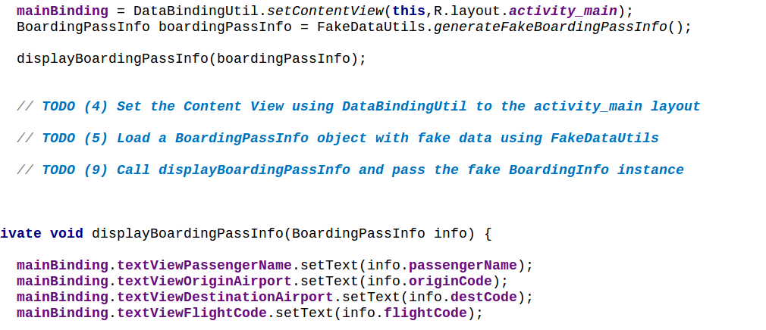
See in pic, setting content view. Then call function which sets hardcoreded value. And pass it in a another functin which will set value to the variables
https://developer.android.com/topic/libraries/data-binding/index.html

Slide 11
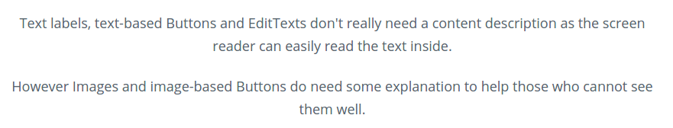
Accessibility

Slide 12
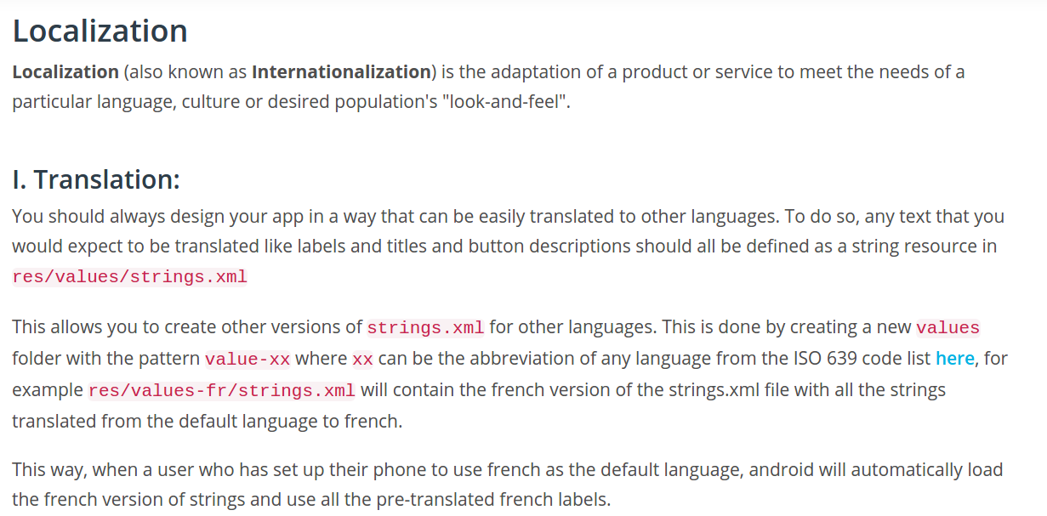
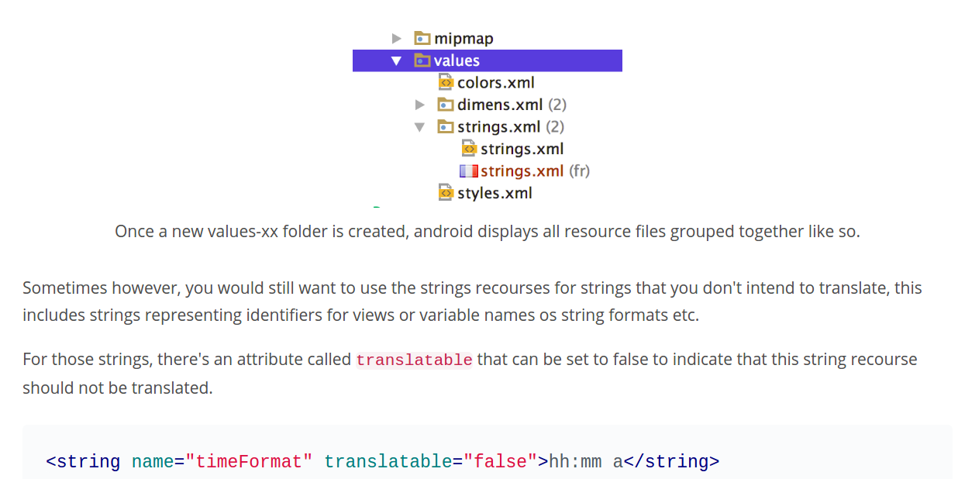

Slide 13
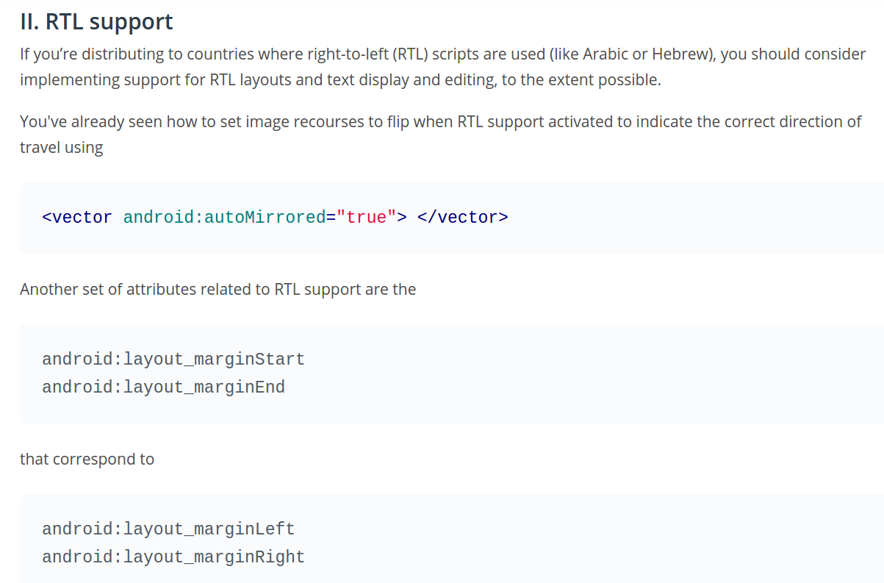

Slide 14
